Slide 1
Take - A - Hike!
By: Jordane Lawrence, Brady Winter, Kyle Hartfield, Charlie Whelden, Wesley Ollinger

Slide 2
Purpose
Provide information about a selection of trails in the Shenandoah Valley
Inform user about difficulty difference in hikes
Allow user to select a hike, start time and length of hike
Alert a contact that the user is starting a hike and time expected to be gone
Alert contact if user did not end hike

Slide 3

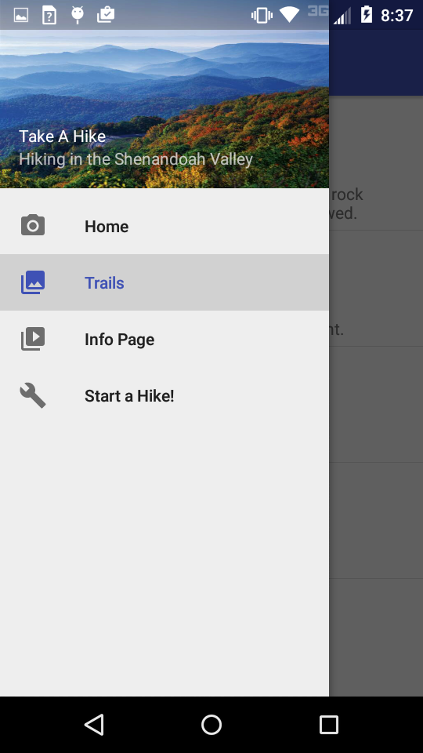
Home Page
Access to the NPS Shenandoah Home page
Provides access to other pages

Slide 4
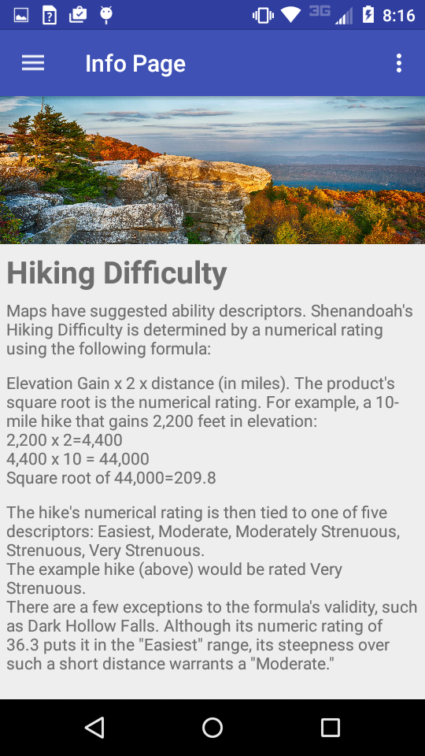
Trail Info Page
Provides details about the hiking trails in Shenandoah Park.
Information provided by National Park Service
Algorithm for difficulty: Elevation Gain x 2 x distance (in miles). The product's square root is the numerical rating. 50 - 210.
Difficulty classes set as Easy, Moderate, Moderately Strenuous, Strenuous and Very Strenuous

Slide 5
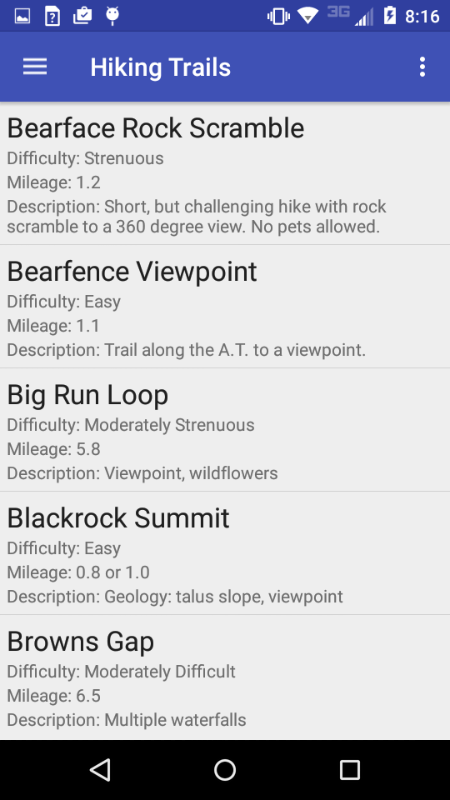
Trails List
Lists trails that are located in the Shenandoah Valley
Provides the name, difficulty, description and distance
Pulls trails from database
Saves database if user loses network connection

Slide 6
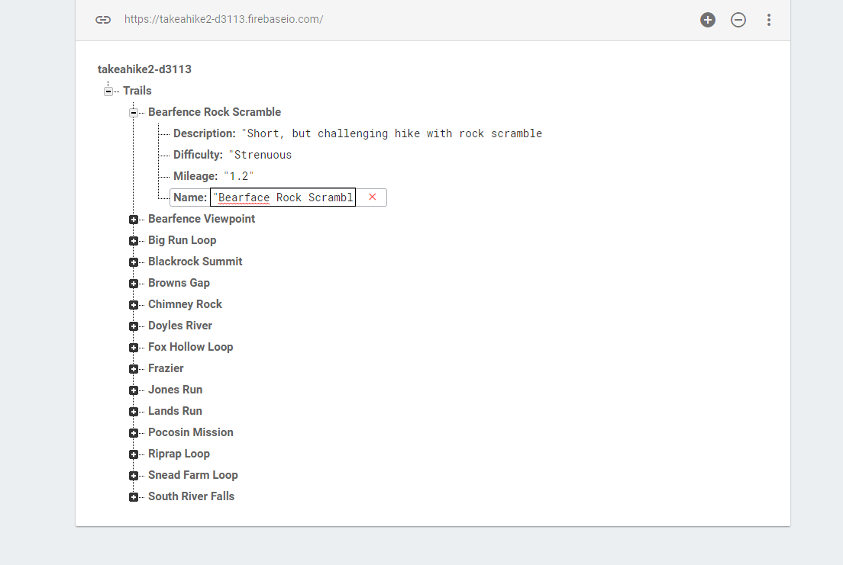
Firebase

Slide 7
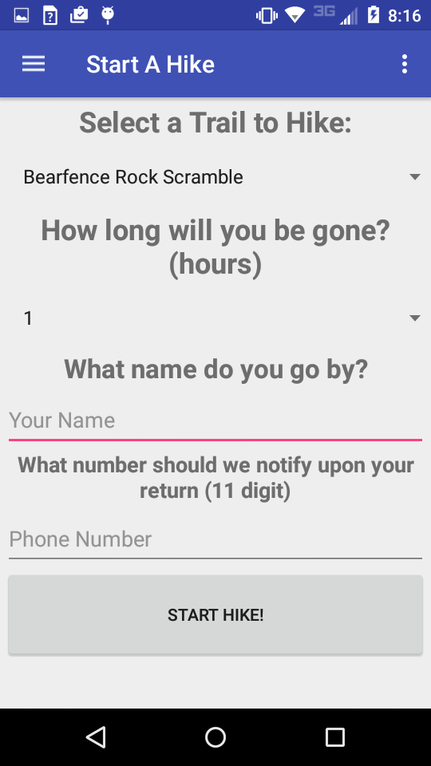
Start a hike!
Prompts user for: - Name that your friend knows you by. - Your friends number. - When you’ll be back - Trail name
Sends an SMS to your friend informing them of details.
Locks you in until you hit “end a hike.”

Slide 8
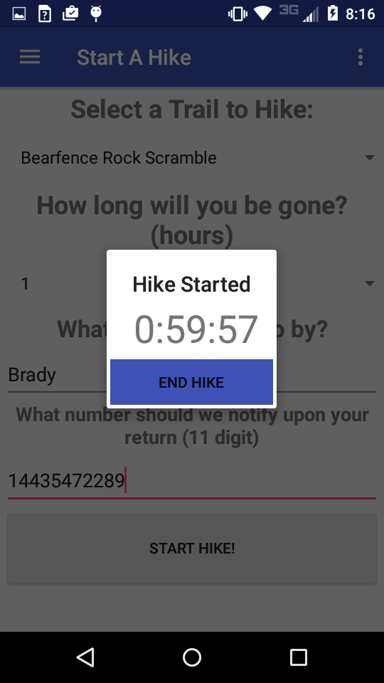
End a Hike
Screen displays a timer of how much time is left set by the user
Once the user ends a hike, another SMS will be sent to the same contact alerting them that time has elapsed
Timer will continue even if app closes

